Slide 1



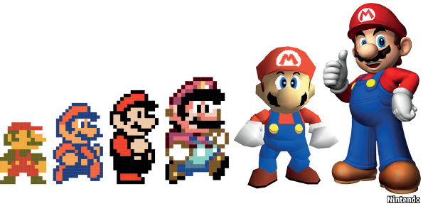
e 🗿
SI 206: Fall 2019 Final Project
SoJung Ham & Dylan Yono

Slide 2
Goals
Between making our final project plan and starting work on the project, our goals changed substantially
(Our original goals involved comparing anime rating data across tracking services, etc.)
Pokemon api -- We wanted to calculate the average base stats for each Pokemon type and compare across type using bar graphs for each base stat.
Mario api -- We wanted to visualize the average rating of Mario games by the decade using a line plot.
Anime api -- We wanted to calculate the average rating of anime based on their source material with a bar graph.

Slide 3
Accomplished Goals
Pokemon API -- accomplished
Mario API -- accomplished
Anime API -- accomplished

Slide 4
Problems encountered
Main problem: Saving 20 items to database
We didn’t know how to save 20 at a time
We thought we figured it out by saving 20 to the cache at a time, but this was wrong
Had to restructure lots of code to have it save to the database 20 at a time
As we did it for each API we got better at doing it more efficiently
VSCode Terminal problem
SQLite package says it’s not installed, despite the fact that it already was.
Ran code in Anaconda Prompt instead
Forgetting misc. small skills such as writing to a text / csv file.
Thank you Stack Overflow!

Slide 5
Instructions for Running
Open your program of choice (mario.py, pokemon.py, anime.py)
Run in Python Terminal Powershell (example: python mario.py)
The program will start extracting data from the API and placing it in the table 20 items at the time. You will keep running the program until it displays options to do other things. This varies for each program, but it’s quite simple.
You can now view graphs, write data to a file, and have fun with the program.

Slide 6
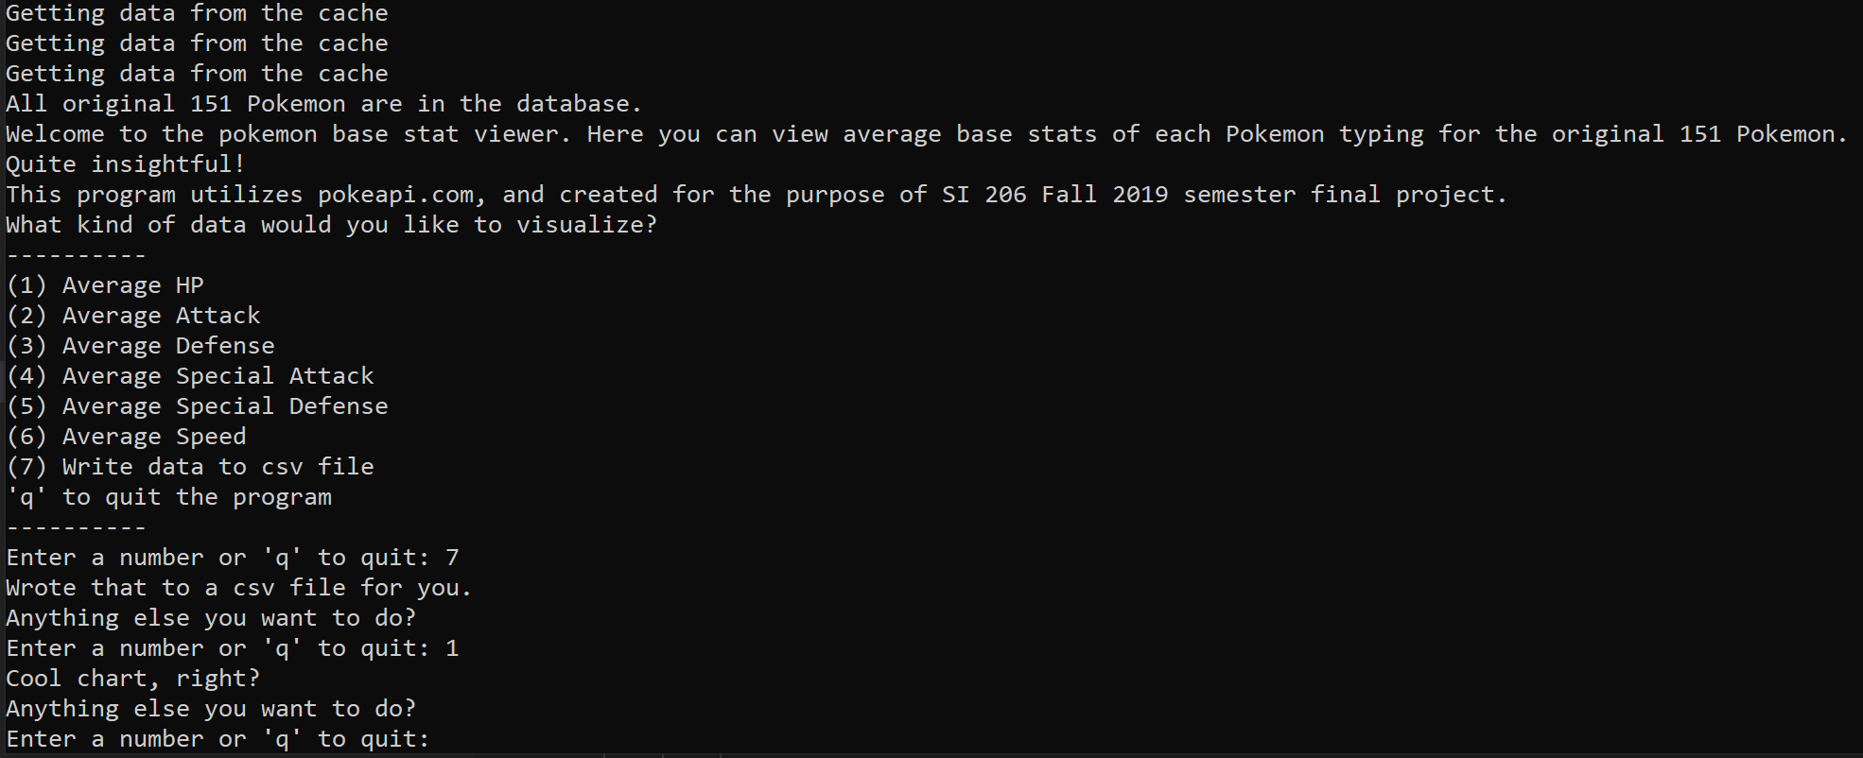
Code Running

Slide 7
Behind the Scenes
Sets up a database
Creates a cache
Collects data from API/cache to save to database
Selects relevant data with a database join
Calculates information of interest (average base stat, average mario game rating, etc.)
Program allows user input to choose what to do
Visualize information in matplotlib
Save data to a text/csv file

Slide 8
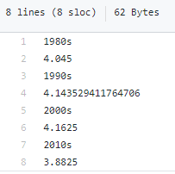
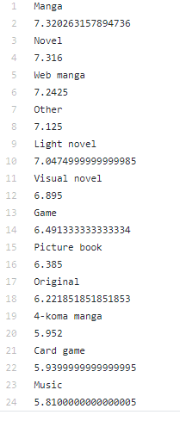
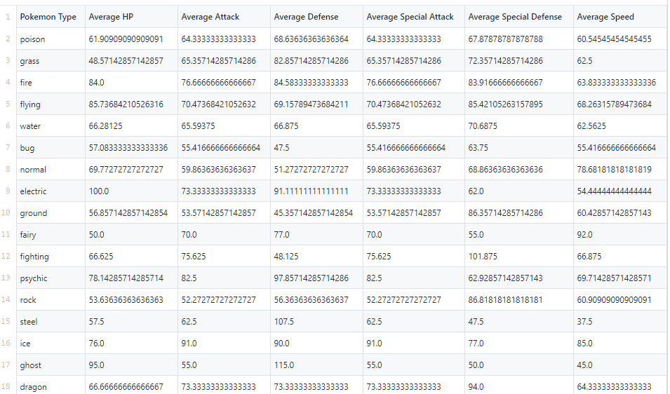
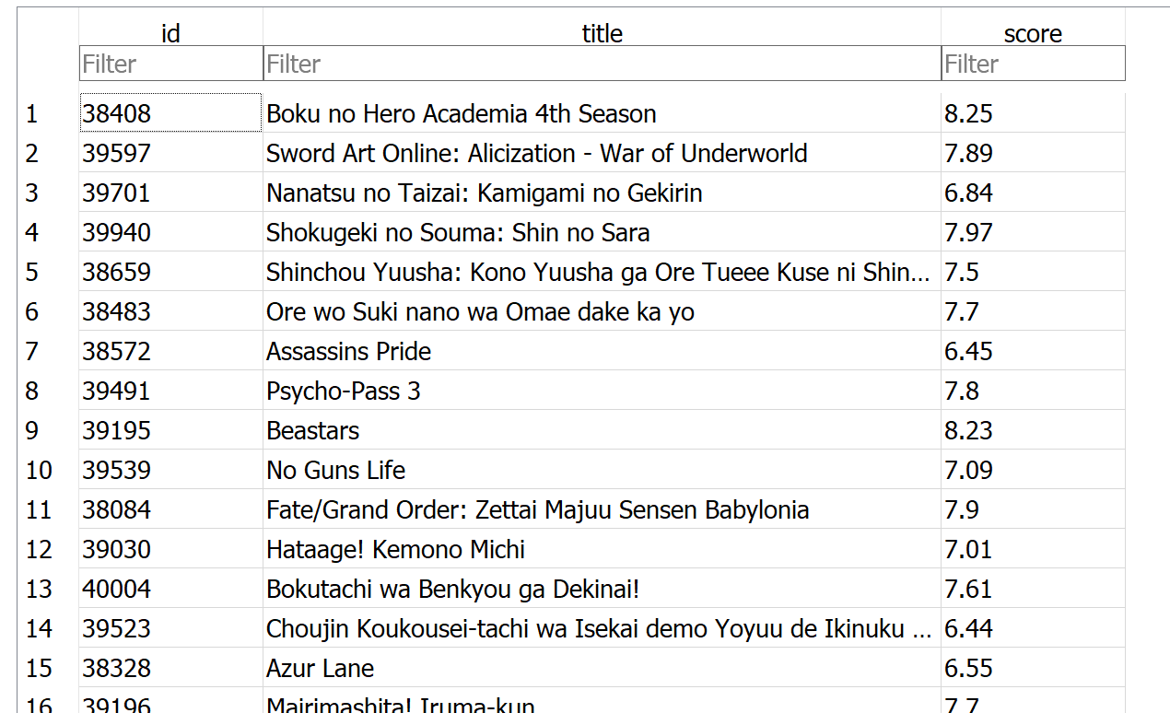
Snapshots of Behind the Scenes

Slide 9
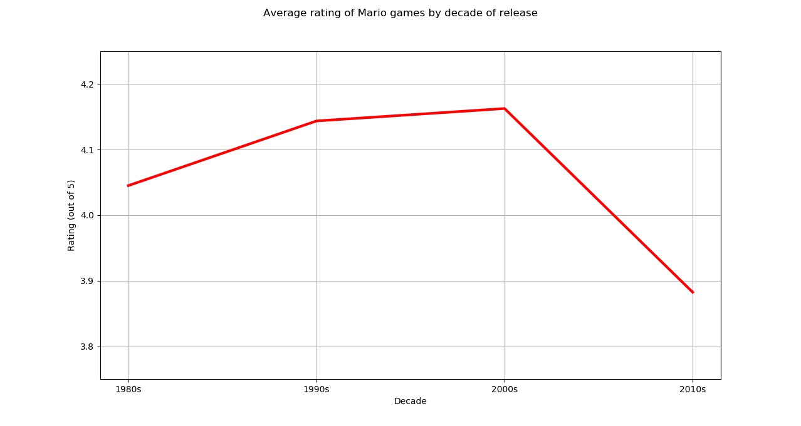
Visualizations - mario.py

Slide 10
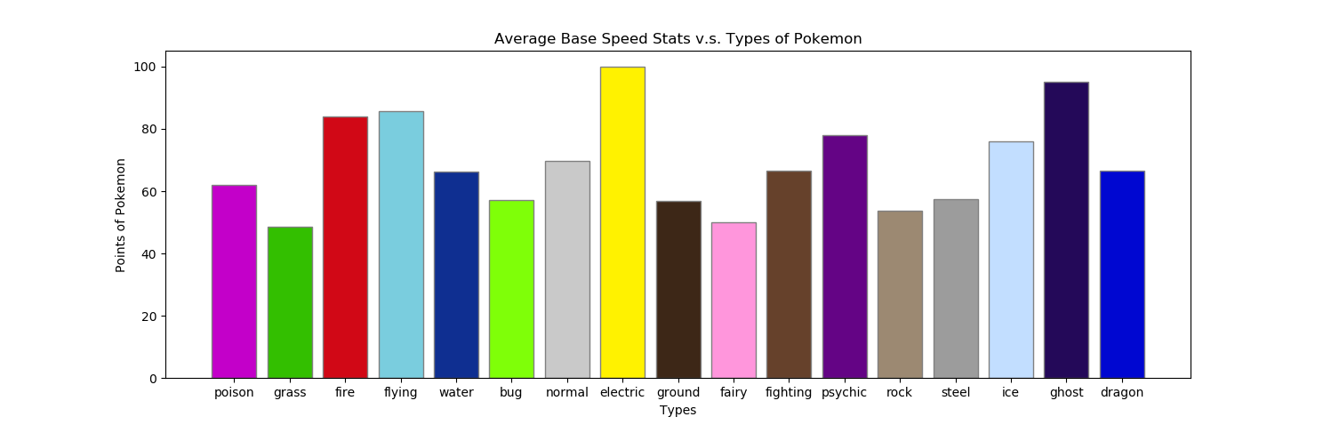
Visualizations - pokemon.py
Insert image here

Slide 11
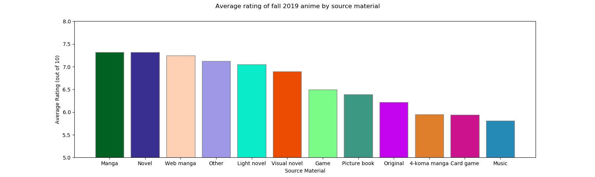
Visualizations - anime.py

Slide 12
The End !

